Slide 1

EVENT MANAGEMENT
INFORMATION SYSTEM
(EMIS)
Presented By Aononto Jahan Junnurain Dept. CSE, IUBAT

Slide 2
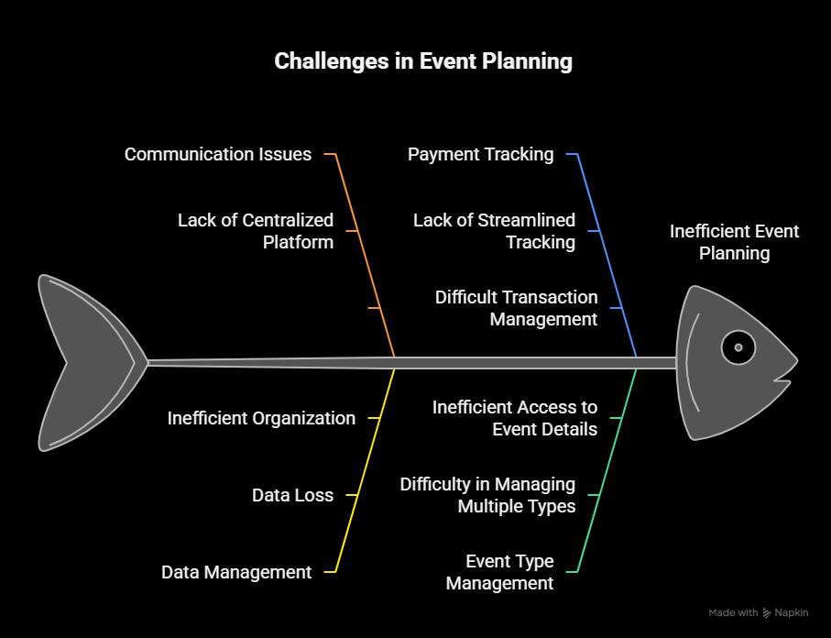

Slide 3
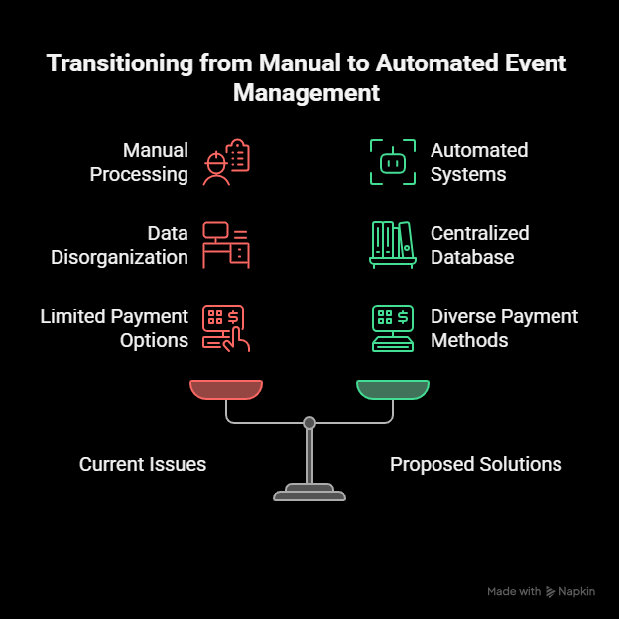

Slide 4
SYSTEM OVERVIEW

Slide 5
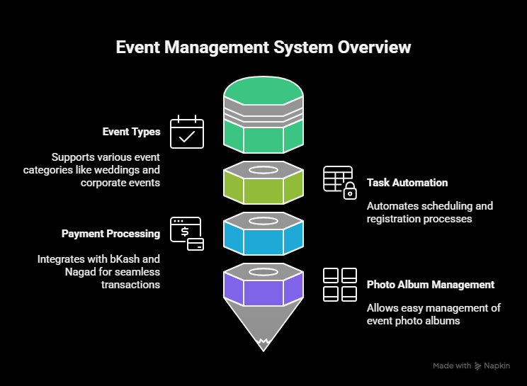

Slide 6
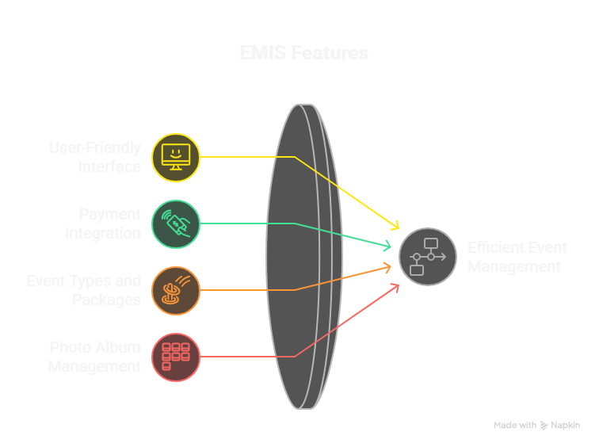

Slide 7
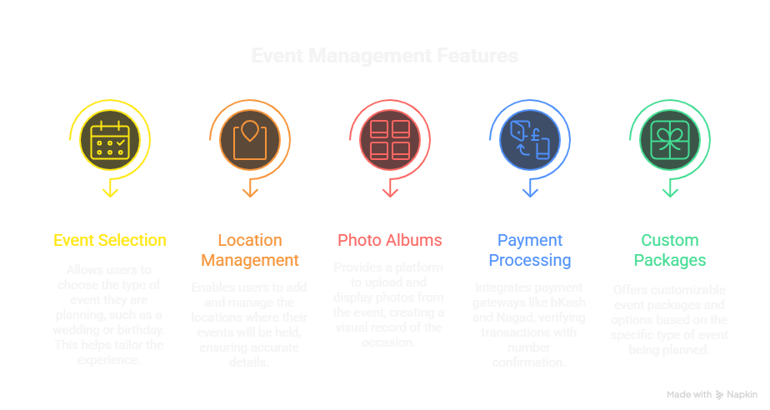

Slide 8
SYSTEM
ARCHITECTURE

Slide 9
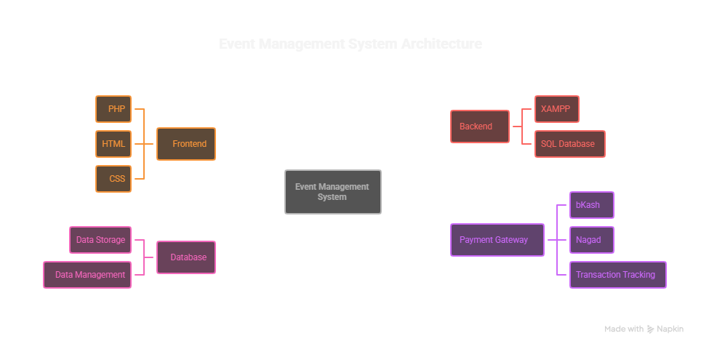

Slide 10
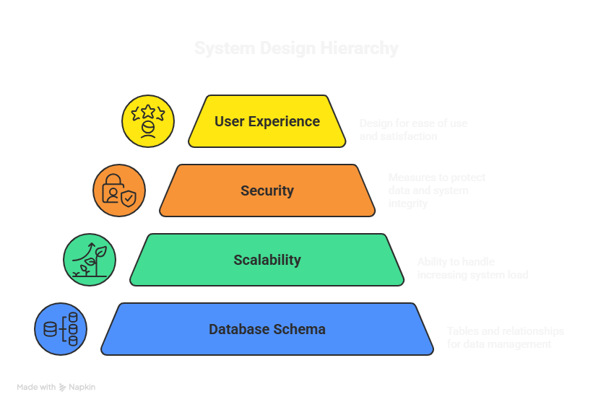

Slide 11
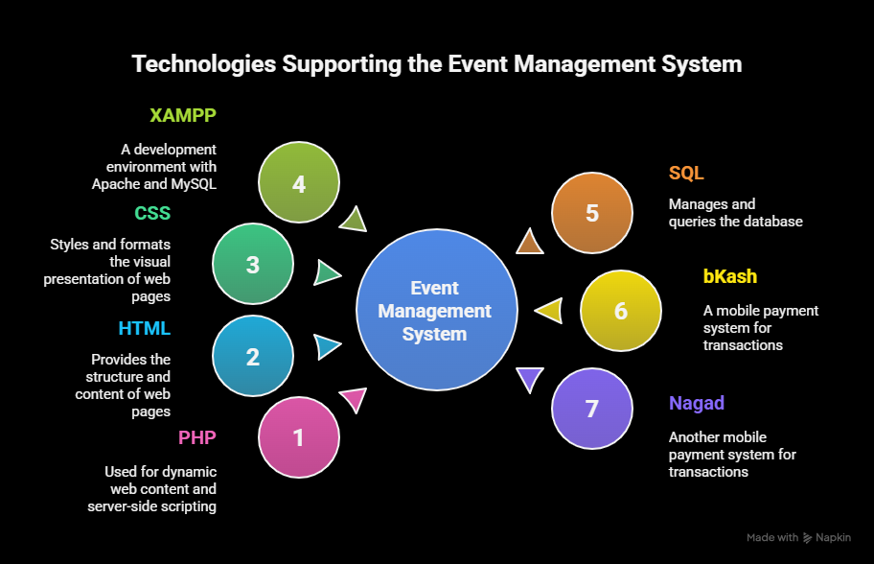

Slide 12
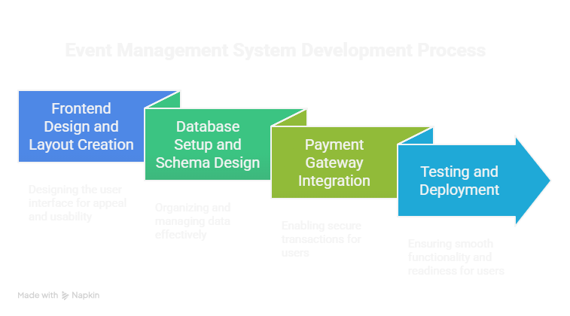

Slide 13
USER
INTERFACE

Slide 14


Slide 15
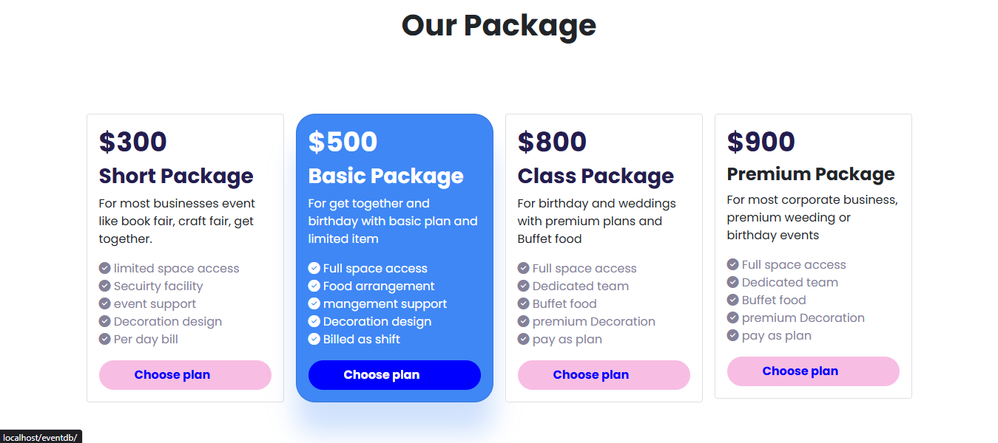

Slide 16
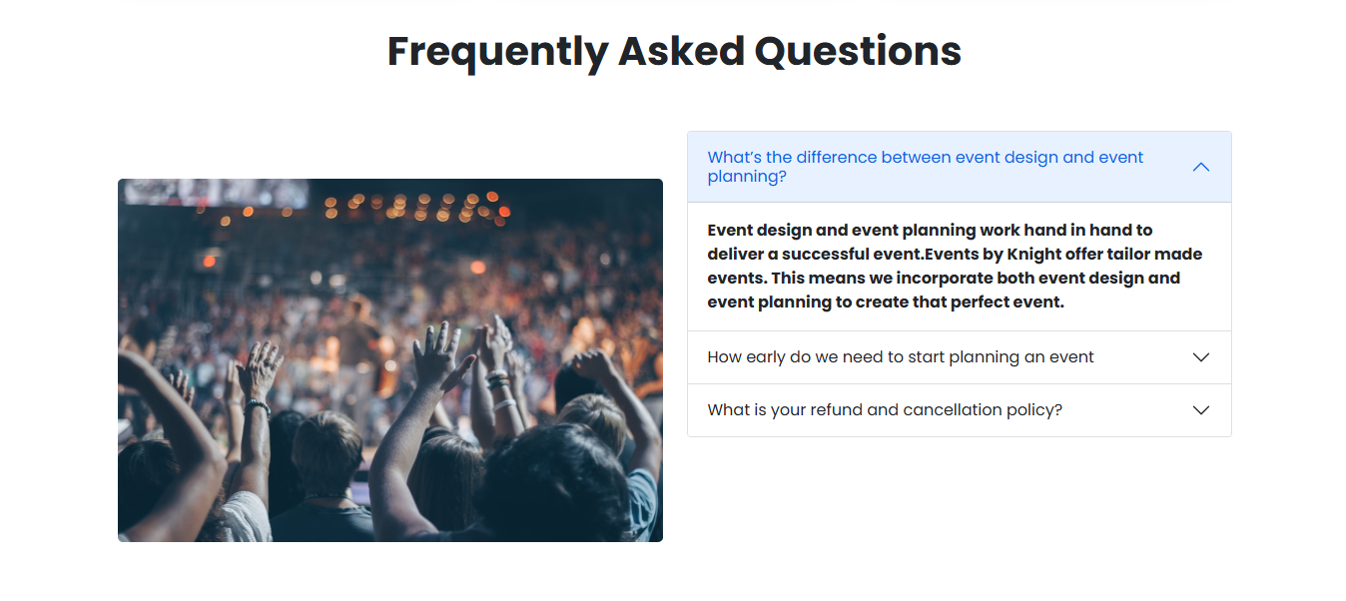

Slide 17
BENEFITS
OF
EMIS

Slide 18
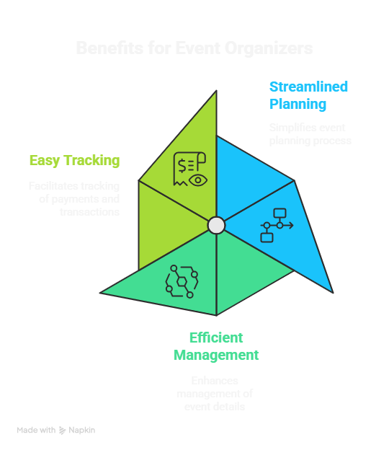

Slide 19
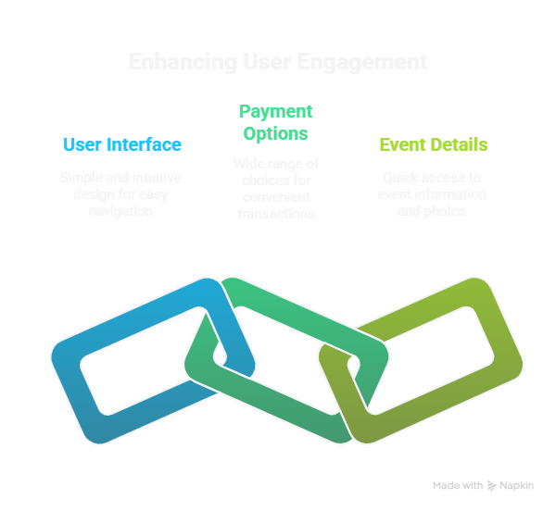

Slide 20
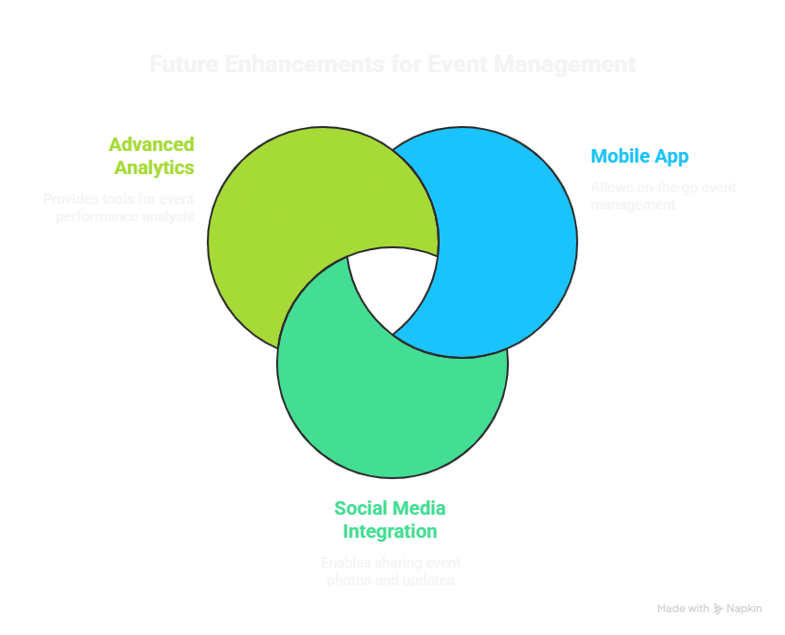

Slide 21
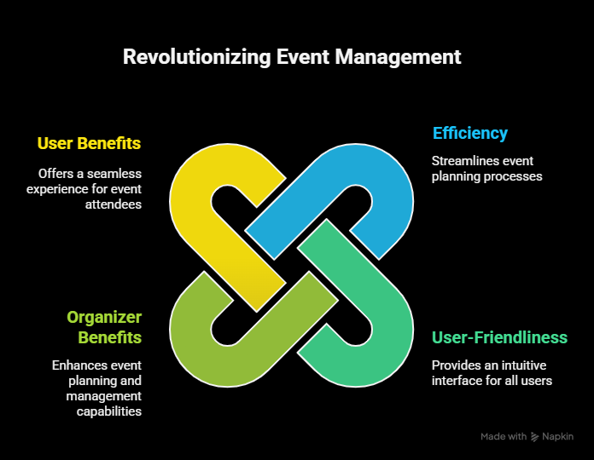

Slide 22
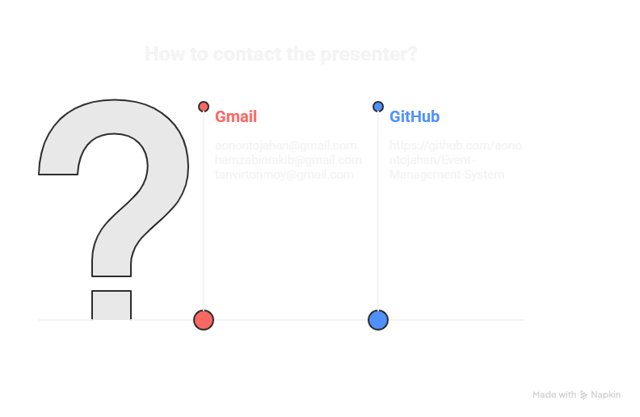

Slide 23



THANK YOU

